Slide 1
Promoting
HEALTH & Well-being
through ART
HEALTH
Well-being
ART
University of West Attica
Department of Public and Community Health​
Laboratory of Hygiene and Epidemiology​
This work is licensed under the Creative Commons Attribution-NonCommercial-ShareAlike 4.0 International License

Slide 2
ART is a form of Creativity.
Whenever someone “makes art” it means,
that while acting creatively he/she has to take a number of different decisions,
therefore he/she takes active part,
in an artistic process.
Creativity & Art, form a pair of interactive, functional human behavior elements.
Human behavior consists of all that someone feels, does and thinks.
Art is both the context and the aftereffect of creativity.
Creativity is the context within which art is evolved.
This presentation is an attempt to explore
how
HEALTH & Well-being can be promoted through
ART
To start, let’s explore the terms
HEALTH
Well-being
ART

Slide 3
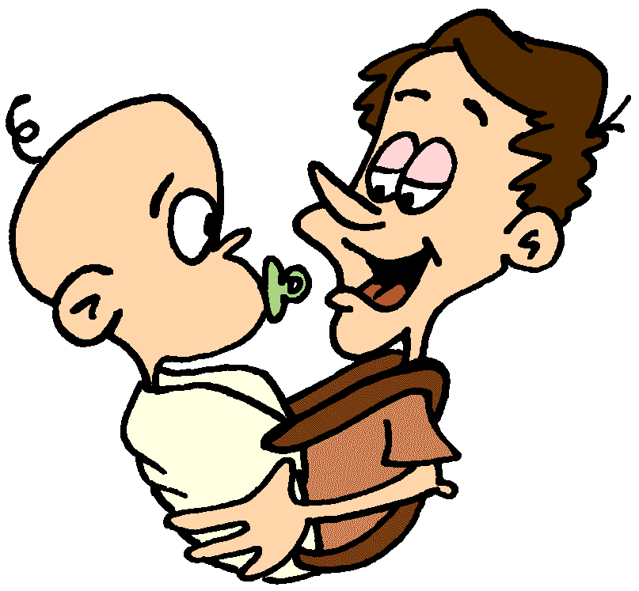
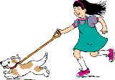
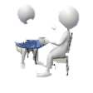
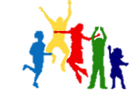
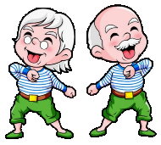
HEALTH
As stated by W.H.O. (1948)
health is
“a state of complete physical, mental and social well-being
and not merely the absence of disease or infirmity,
therefore, a dynamic process that, at its core, is about having the capacity to self-manage.”
According to W.H.O. (2019) in society culture and health are linked,
given the fact that the cultural context has a shaping effect on health.
Additionally, health can be promoted at both an individual and a society level.
W.H.O.’s definition focuses on Well-being , from both individual and social perspective.
Well-being
W.H.O. (2019) Arts and Health. Retrieved from: https://www.who.int/initiatives/arts-and-health
W.H.O. (1948). Constitution. Retrieved from: https://www.who.int/about/governance/constitution
& https://apps.who.int/gb/bd/PDF/bd47/EN/constitution-en.pdf?ua=1

Slide 4
W.H.O. about
Well-being :
Α positive state in which physical, mental, psychological and social health,
as well as a sense of pleasure and happiness
are consciously felt.
Well-being
is in constant interaction with
HEALTH
W.H.O. (2019) Fancourt, D. , Finn, S. What is the evidence on the role of the arts in improving health and well-being? A scoping review. Retrieved from: https://apps.who.int/iris/bitstream/handle/10665/329834/9789289054553-eng.pdf?ua=1

Slide 5
ART’s function
as a tool used to promote
HEALTH
Well-being
HEALTH
&
artistic creative practices
Well-being
culture
literature
music
ART as a tool
performing arts
ART
visual arts, design and craft
online, digital & electronic arts

Slide 6
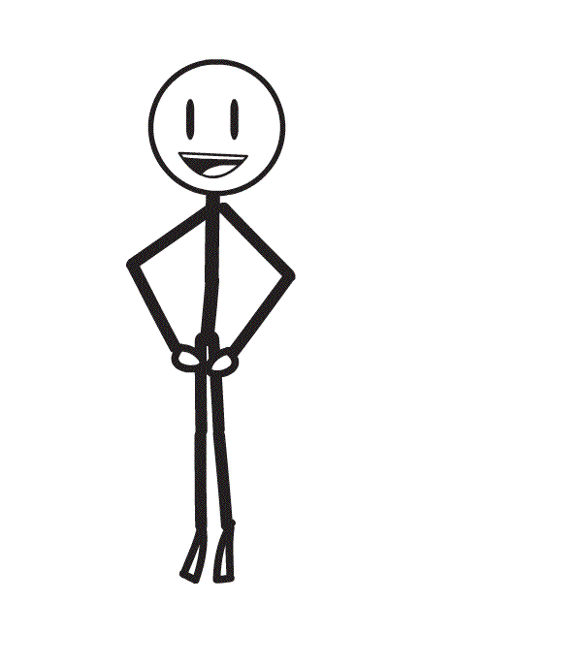
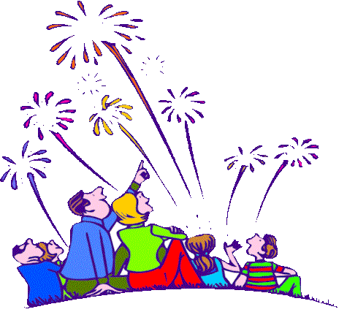
is like a region consisted of different bordering areas and processes.
ART
W.H.O. in 2019 recognised 5 wide-ranging artistic areas
• performing arts (e.g. activities in the genre of music, dance, theatre, singing and film)
• visual arts, design and craft (e.g. crafts, design, painting, photography, sculpture and textiles)
• literature (e.g. writing, reading and attending literary festivals)
• culture (e.g. going to museums, galleries, art exhibitions, concerts, the theatre, community events, cultural festivals and fairs)
• online, digital and electronic arts (e.g. animations, film-making and computer graphics)
W.H.O. (2019) Fancourt, D. , Finn, S. What is the evidence on the role of the arts in improving health and well-being?
A scoping review.
Retrieved from: https://apps.who.int/iris/bitstream/handle/10665/329834/9789289054553-eng.pdf?ua=1

Slide 7
cannot be strictly defined, because of :
its flexibility in terms of processes
the freedom that its function requires
its timeless and cross-cultural qualities
the complexity of its role
ART
Therefore, it is necessary to be approached
from a holistic point of view.
In these terms, ART could be considered, within an artistic context, as :
a situation
an activity
an event
an engagement
a cause and result simultaneously
a region consisting of different but interactive bordering areas and processes
artistic context

Slide 8
For the purposes of this presentation, ART is defined as:
ART
…a process which consists of optional and highly flexible components, that provoke a double-edge involvement (i.e. active and receptive participation), which is communicated through physical sensations, thoughts and emotional responses.
process
…a medium that enables both interpersonal and intrapersonal communication, (i.e. approaching hidden desires, repressed feelings, etc.).
medium
…a vital spacetime which is defined and delimited by the proceed-along artistic process. From this point of view, it is evident how ART can function as a tool for the promotion of Health and Well-being, as a safe-space allowing personal expression and self reflection.
vital spacetime
Considering these as guidelines, this presentation will explore how ART’s function interweaves Creativity with Health & Well-being through creative practices, in a lively relationship.
ART’s function

Slide 9
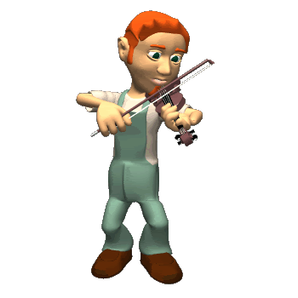
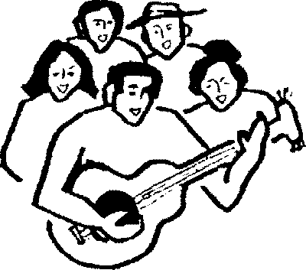
Artistic process, involves active participation, which is communicated through sensations, thoughts, emotional and physical activities or responses.
process
Participating actively in ART is a practical experience, i.e. an energetic sequence of steps that supports the creation of an art object, either physical or empirical.
Every active artistic process entails some basic elements in constant interaction with each other, from the beginning to the end of the whole experience :
Inspiration/Idea
Development (practical or empirical)
Creation (physical or experiential)
Encouragement of mingling & socializing
Presentation (optional)
Reflection (optional) (interpretation, emotional response, e.t.c.)
A person who actively participates in an artistic process acts as a creator. As the process unfolds, the creator him/herself functions simultaneously as observer/viewer/listener, etc. of his/her own art. Therefore, active artistic process turns the creator into the first recipient of his/her own artwork.

Slide 10
Every artistic process, no matter if it is an energetic action or a receptional response,…
process
… it is also:
an informative physical or empirical experience
a solitary or social practice
a unique personal journey
a safe space to play & try/discover new experiences
an opportunity for socializing and connecting with others/society
…stems from Art’s creative or teaching practices, which are art-based methods aiming to introduce people to the sense of creation.
They include physical or experiential artistic techniques and they can be adapted to every level of physical, mental or psychological need and ability.
…requires :
space and time
engagement (physical or empirical)
experiential elements (i.e. sounds)
material substances, objects and equipment (found, bought or self made)
…gives birth to:
ideas
thoughts
questions
…includes:
instructions
other processes

Slide 11
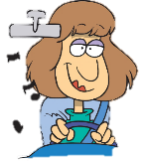
Artistic process involving receptive participation
process
Every receptive artistic process provokes several reactions in constant interaction with each other, from the beginning to the end of the whole experience and causes a number of outcomes :
pause
Triggering Inspiration/Thoughts/Ideas at at at at
Encouraging mingling & socialising at at pause
Development (psychological or mental) pause
Energetic Response (physical or experiential)) a a
Performance (co-acting/co-creating) (optional)
Reflection (interpretation, emotional response, etc.) (optional)
When one involves oneself receptively in an artistic process, one is also acting energetically :
A a a
as a responsive attendant at an artistic event/happening/incident, in terms of physical senses, mental interpretations or thoughts as well as psychological reactions, i.e. emotional responses. A a a a a a a a a
as a responsive spectator in the sight of physical artworks.
Participating receptively in ART is a lively inner experience i.e. a variety of responses towards a physical or empirical art object.

Slide 12
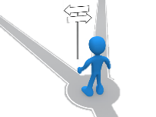
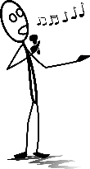
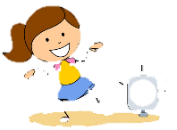
Engaging with artistic processes promotes Well-being , because …
process
Well-being
…it offers :
resource for thoughts & feelings
bodily expression
alternative learning sources
cultivation of new skills
… it teaches :
how to act in moderation
how to stay focused
how to free imagination
how to express thoughts and feelings
how to follow instructions fruitfully
alternative communicative skills
… it stimulates :
inspiration
expression
communication
socialisation
innovation
cultivation in all aspects

Slide 13
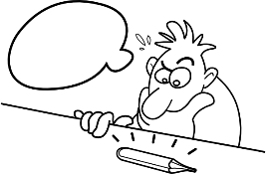
One does not need to be an artist in order to participate in an artistic process because the core of the process’ aim is the process itself.
process
Involving in an artistic process could be achieved through :
Facilitator or self-directed engagement
(directly) self activity as a creator
(indirectly) receptive engagement, as a spectator, listener, attendant etc.
When artistic processes aim to trigger & develop well-being, they do not require :
special skills or talents
academic aspiration or commercial aesthetic value, in relation to the artistic creation or product
to end up with a created specific art object.
Artistic process’ benefits : a a a a a a a a a a a a a a a a aa
develops psychological, physical, mental & social skills
constantly increases self-awareness, especially in regard to notion of “the other”, as well as in regard with the notion of “myself”
reveals hidden or forgotten mental abilities & skills
encourages feelings like satisfaction
cultivates determination

Slide 14
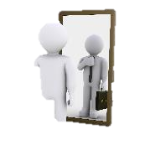
Art can function as a medium of alternative & easier communication…
medium
…with one’s inner self
… amongst people
Artistic processes
enable people to come in contact with their inner self by providing countless symbols and a variety of alternative ways and means of expression.
Artistic processes
provide opportunities to
engage and communicate
with others.
Directly
Indirectly
Creative
active or receptive participation within a group workshop context.
Receptive participation through artworks
in solitary privacy
or
amongst others in a group.

Slide 15
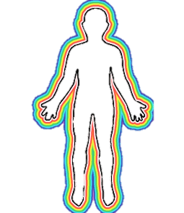
Art functions as a safe-space because, it provides an opportunity for adults to feel playful and act free of critical evaluation. Artistic processes create a kind of innocent, unexplored universe, open to anyone who needs to try new things with materials, thoughts & feelings, without critical concerns.
vital spacetime
Artistic creation :
offers a shockproof field of emotional release
stimulates inspiration, memory, feelings
Artistic process decreases tension
Active creation through an artistic process or receptive participation of an artwork :
stimulates new thoughts & feelings, therefore, provides an opportunity for self-awareness
triggers imagination and memory
increases creativity

Slide 16
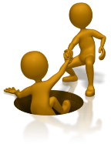
ART’s function
Art as process , medium or vital spacetime promotes well-being by developing alternative opportunities for people to engage and communicate with others, as well as with their own self.
ART
process
medium
vital spacetime
Well-being
People interacting through an artistic process can experience otherness as a fruitful way of communication and positive interaction.
Furthermore, while engaging with ART people can feel evenly and proportionately equal, as they confront their own feelings or ignorance about new personal experiences, privately or in public.

Slide 17
Here are two examples, which clearly describe how
ART leads to Well-Being
ART
Well-being
On the first example, the initial motive of the artistic creation, had to do with promoting Flemish art, by filling with artworks, anonymous public spaces, like airports’ waiting rooms. As one can see on the filmed art-documentation following, the venture evolved into a public call for participatory well-being. The actual artwork, which will be presented, is “Rubens Cupid” (2018), a digital artwork, created by the artistic collective “Skullmapping” and inspired from an original painting of Sir P.P. Rubens.
The second example, that will follow the first, has to do, with the unique musical group Stomp, which was established on 1994. Stomp, engages its audience, by surprising it, using simple everyday movements as dance and ordinary objects, as ..musical instruments.

Slide 18
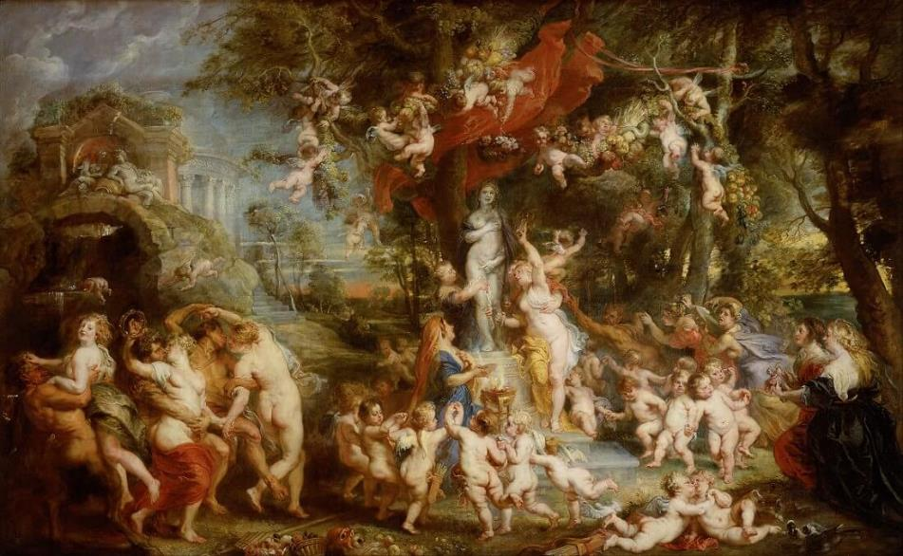
Let’s first take a close look at the original artwork of the Rubens’ painting The Feast of Venus (1636)
Sir Rubens, Peter Paul (1577 -1640). The Feast of Venus- 1636 [painting]. Retrieved from www.peterpaulrubens.net/the-feast-of-venus.jsp

Slide 19
At Brussel’s airport, in a public waiting room full of people, passengers are walking, sitting or waiting on lines. On the walls are hanging famous artworks, such as the one on the previous slide, which was created by P.P. Rubens (1577 -1640).
All of a sudden, a small painted angel extracts itself from the Rubens’ painting and flies around giving an amusing performance. The small flying mischief-maker is an artistic projection, that meant to attract peoples’ attention.
Here is what happened:
1st
example
Watch a video here:
https://skullmapping.com/project/rubens-cupid/
Video Credits : Sterckx, F., Verbeeck, A., Sterckx, B. (Skullmapping). Rubens Cupid. 2018 [digital artwork]. Retrieved from https://skullmapping.com/project/rubens-cupid/

Slide 20
Obviously, when an artwork is designed and presented in a proper way, it is possible to stimulate peoples’ feelings of joy, even during a common dull day. Travelers, passengers and staff, some of them maybe bored or anxious, where all, more or less engaged with that unexpectedly presented artwork.

Slide 21
Stomp introduces to its audience music created by objects widely used in everyday life, as for instance zippo lighters, buckets, brooms or matchboxes.
Combining music created by unexpected objects with dance and theatrical performance, the group engages its audience in an inventive and stimulating show.
Once the group saw in newspaper an ultimate musical instrument. Let’s watch the result:
2nd
example
Watch a video here:
https://www.youtube.com/watch?v=7NhFmARAgu0
Video Credits : “Stomp – newspapers” (2010) https://www.youtube.com/watch?v=7NhFmARAgu0

Slide 22
No matter where artistic expression stems from. When artistic inspiration meets its audience, ART meets its main purpose.

Slide 23
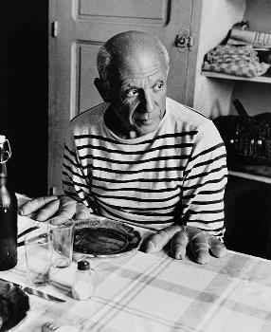
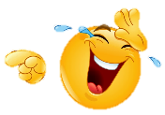
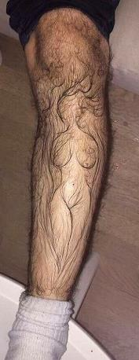
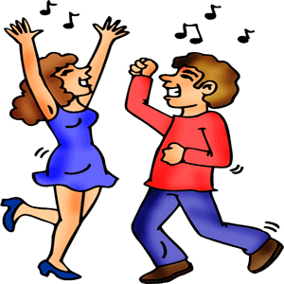
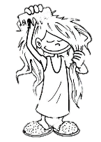
In ART one can use everything, anywhere and whenever he/she feels inspired to do so. Especially spontaneous artistic improvisation connects directly personal expression with
Well-being
ART
Well-being
ART’s function, when used to improve
the quality of everyday life
and unfolded from experienced hands,
it is truly a powerful tool.
ART’s function
quality of everyday life

Slide 24
REFERENCES
Abramovic, M., Kaplan, J. (2016). Walk Through Walls. U.S.: Crown Archetype
Adorno, T. (2000). Résumé über Kulturindustrie. Μτφρ. Λ. Αναγνώστου. Αθήνα: Αλεξάνδρεια
Alberti, L. B , Baudelaire C. Bellori, G. P., Blake, W., Delacroix, E., Diderot, D., Dürer, A., Fuseli, H., Goethe J. S. (von)., Kant, I., Piles, R. (de)., Poussin, N., Proudhon, P.-J., Richardson, J., Riegl, A., Ruskin, J., Schopenhaouer, A., Wagner, R., Wilde, O., Winckelmann, J.J. (2014). Art and Creativity –an Anthology. Αθήνα: Ed. K. Βασιλείου ΠΛΕΘΡΟΝ
Arendt, H. (2012). Crice de la culture. Η Κρίση της Κουλτούρας και άλλα κείμενα. Μτφρ. Γ.Ν. Μέρτικας. Αθήνα: ΣΤΑΣΕΙ ΕΚΠΙΠΤΟΝΤΕΣ
Arnheim, R. (2005). ART and VISUAL PERCEPTION : A Psychology of the Creative Eye.. (Γ’ έκδοση). Μτφρ. Ι. Ποταμιάνος. Αθήνα: ΘΕΜΕΛΙΟ
Arnheim, R. (2003). ENTROPY & ART AN ESSAY ON DISORDER & ORDER. Μτφρ. Ι. Ποταμιάνος. Ed. Ι. Ποταμιάνος, Γ. Βρυώνη Θεσσαλονίκη: UNIVERSITY STUDIO PRESS AE.
Arnheim, R. (2007). VISUAL THINKING. Μτφρ. Ι. Ποταμιάνος, Γ. Βρυώνη. Θεσσαλονίκη: UNIVERSITY STUDIO PRESS AE.
Aristotle Nikomachean Ethics [Ἠθικὰ Νικομάχεια] (1098b-1099b). Retrieved from: https://www.greek-language.gr/digitalResources/ancient_greek/library/browse.html?text_id=78&page=8
Aristotele. (1994) On Interpretation.-- Περί Ερμηνείας, εκ. Ο. Χατζόπουλος, Κάκτος, ΑΘΗΝΑ
Aristotle. Poetics [Ποιητική] (1448b-24 κ.ε). Retrieved from: https://www.greek-language.gr/digitalResources/ancient_greek/library/browse.html?page=5&text_id=76
Barthes, R. (2007). IMAGE –MUSIC-TEXT. Μτφρ. Γ. Σπανός. Αθήνα: ΠΛΕΘΡΟΝ
Baudelaire, C. (1995). Art romantique in Aesthetic Essays. 1868. Μαρία Ρέγκου. Αθήνα: Printa
Benjamin, W. (2003). The Author as Producer. 1934. in Art in Theory 1900-2000. USA, UK, Australia: Harrison, Charles & Wood, Paul. eds. Blackwell Publishing
Benjamin, W. (2003). The Work of Art in the Age of Mechanical Reproduction. 1936 in Art in Theory 1900-2000. USA, UK, Australia: Harrison, Charles & Wood, Paul. eds. Blackwell Publishing
Bouleau, C. (2002). The Painter's Secret Geometry: A Study of Composition in Art. Μτφρ. Σ. Δήμου. Αθήνα: Ένωση Καθηγητών Καλλιτεχνικών Μαθημάτων
Boyle, R. (1964). Experiments and Considerations Touching Colours. New York, London : Johnson Reprint Corporation
Cage, J. (2003). On Robert Rauschenberg, Artist, and his Work. 1961 in Art in Theory 1900-2000. USA, UK, Australia: Harrison, Charles & Wood, Paul. eds. Blackwell Publishing
Chapman, L. H. (1993). Approaches to Art in Education. Μτφρ .Α. Λαπουρτάς, Γ. Χαραλαμπίδης, Ε. Κυπραίου, Α. Βαρδάλου. Ed. Π. Χριστοδουλίδης. Αθήνα: ΝΕΦΕΛΗ

Slide 25
Chemi,T., Xiang,Y. (ed.) (2018). Arts-Based Methods in Education Around the World. Retrieved from: https://www.researchgate.net/publication/322583683_Arts-Based_Methods_in_Education_Around_the_World
Classen, C. (2005) 24.Touch in the Museum. in The Book of Touch. N. York: Berg. Oxford
Crysoulakis, S. (ed.) (1985) The Birth of Writing. Αθήνα : ΤΑΠ
Doyal, L. & Harris, R. (1986) Empiricism, Explanation and Rationality an Introduction to the Philosophy of the Social Sciences. London: Routledge & Kegan Paul
Ehrenzweig, A. (1953) The Psychoanalysis of Artistic Vision and Hearing: an introduction to a theory of unconscious perception. London , New York : Braziller
Finnegan, R. (2005) 1. Tactile Communication in The Book of Touch. N.York: Berg. Oxford
Free online converter “Text to speech” , Female voice: Amy. : https://readloud.net/english/british/5-female-voice-amy.html
Fuller, Peter. (1988). Art and Psychoanalysis, Φούλλερ, Πήτερ. Τέχνη και Ψυχανάλυση, μτφρ. Η. Κανακάκη, ΝΕΦΕΛΗ, ΑΘΗΝΑ
Giorn, A. (2002) Pur la forme. Ebauche d’une methodologie des arts. -- Περί Μορφής. Σκιαγραφία μιας μεθοδολογίας των τεχνών. Μτφρ.Γ. Ιωαννίδης, Σ. Σκούφος. Αθήνα: ΝΗΣΙΔΕΣ
Gombrich, E. H. (1998) The Story of Art. Μτφρ. Λ. Κασδάγλη. Αθήνα: Μορφωτικό Ίδρυμα Εθνικής Τραπέζης
Goethe, J. W. (1940) Theory of Colours, Charles Lock Eastlake, Cambridge, Massachusetts, London: M.I.T. Press
Hamilton, E., Kephallénos, J., Balzac, H. (de), Baudelaire, C., Dalí, S., Degas, E., Ducasse, I. L. (Conde de Lautréamont), Moore, H., Nietzsche, F., Pappas, Y., Picasso, P., Rodin, A., Valéry, P., Zervos, C., (1993). ΚΕΙΜΕΝΑ ΓΙΑ ΤΗΝ ΤΕΧΝΗ. Μτφρ. Γ. Παππάς. Αθήνα: ΝΕΦΕΛΗ
Houser, A. (1989) The Social History of Art. (Volume 4). Μτφρ. Τ. Κονδύλης. Αθήνα: ΚΑΛΒΟΣ
Itten, J. (1998) Kunst der Fabre. Μτφρ. Ι. Ομορφοπούλου. ΑΘΗΝΑ: Ένωση Καθηγητών Καλλιτεχνικών Μαθημάτων.
James, William. (1912) Essays in Radical Empiricism. New York, London, Bombay, Kalcutta: Longmans, Green, and Co.
Kandinsky, W. (1981) Concerning the Spiritual in Art. Μτφρ. Μηνάς Παράσχης. Αθήνα: ΝΕΦΕΛΗ
Kokkinou, T., Dikaiakou, A. (2007) ‘Plaster casts of human limbs, in the asylum’s spacetime of Leros’ psychiatric hospital 1994’ in ART & PSYCHIATRY - ΤΕΧΝΗ & ΨΥΧΙΑΤΡΙΚΗ. Liodakis, A., Tzanakis, M., Tsourtou, V. (eds.) Αθήνα : Focus And Health Ε.Π.Ε.
Kosuth, J. (2003) Art after Philosophy. 1969 in Art in Theory 1900-2000. USA, UK, Australia: Harrison, Charles & Wood, Paul. eds. Blackwell Publishing. Also available from : https://monoskop.org/images/4/46/Kosuth_Joseph_1969_1991_Art_After_Philosophy.pdf

Slide 26
Kuriyama, S. (1999). Expressiveness of the body and the Divergence of Greek and Chinese Medicine. U.S.A.: Urzone, Inc.
Krueger, L. (1982) 1. Tactual perception in historical perspective: David Katz’s world of touch. in Tactual Perception: A Sourcebook. Cambridge: Cambridge University Press
Labraki-Plaka, M. (1986). BAUHAUS from Idealism to Functionalism. Αθήνα: ΝΕΦΕΛΗ
Μάτσα, Κ. (2001). Ψάξαμε Ανθρώπους και Βρήκαμε Σκιές. Αθήνα: Άγρα
Mastrandrea, S., Fagioli, S., Biasi, V. (2019). Art and Psychological Well-Being: Linking the Brain to the Aesthetic Emotion. Frontiers in Psychology, Volume 10
Merleau-Ponty, M. (1962) Phenomenology of Perception. London, New York: Colin, Smith. Routledge & Kegan Paul
Merleau-Ponty, M. (2003). ‘Eye and Mind’ in Art in Theory 1900-2000. USA, UK, Australia: Harrison, Charles & Wood, Paul. eds. Blackwell Publishing
Moran, D. (2008) INTRODUCTION TO PHENOMENOLOGY, London, New York: Routledge Taylor & Francis Group
Newton, I. (Sir) (1973) The unpublished first version of Isaac Newton’s Cambridge lectures on optics 1670-1672. Cambridge: Cambridge The University Library
Plini G.S. the Elder. Natural History Books 33–37: Minerals (and medicine), the fine arts, and gemstones. Retrieved from : https://ia600208.us.archive.org/2/items/cu31924031053550/cu31924031053550.pdf & https://www.perseus.tufts.edu/hopper/text?doc=Perseus%3Atext%3A1999.02.0137%3Abook%3D35%3Achapter%3D40 )
Πλίνιος ο ΠΡΕΣΒΥΤΕΡΟΣ. (1994) ΠΕΡΙ ΤΗΣ ΑΡΧΑΙΑΣ ΕΛΛΗΝΙΚΗΣ ΖΩΓΡΑΦΙΚΗΣ. ΜΤΦΡ. Τ. Ρούσσος, Α. Β. Λεβίδης. Ed.Α. Λεβίδης. Αθήνα: ΑΓΡΑ
Polanyi, M. (1969) Knowing and Being. London: Routledge & Kegan Paul
Prossser, J. 3. Skin memories in Thinking through the skin. Ahmed Sara & Stacey, Jackie (ed.) (2001), London: Routledge
Sluys, F. and Legrand, F.C. (1955). Archiboldo et les archoboldesques. Brussels: André De Rache, Aalter
Tanizaki, J. In praise of shadows (1933) // Το εγκώμιον της σκιάς (1992) Μτφρ. Π. Ευαγγελίδης. Αθήνα: ΑΓΡΑ, also Retrieved from http://www.dodici12.com/docs/Tanizaki-JunIchiro-In-Praise-of-Shadows.pdf (eng), https://vdoc.pub/download/-6vmpve9aq590 (ελλ) 31.10.22
Thayer, Stephen. (1982) 8. Social Touching in Tactual Perception: A Sourcebook. Schiff, William & Foulke, Emerson (eds.) Cambridge; London; New Rochelle; Melbourne; Sydney : Cambridge University Press

Slide 27
W.H.O. (1948). Constitution. Retrieved from: https://www.who.int/about/governance/constitution & https://apps.who.int/gb/bd/PDF/bd47/EN/constitution-en.pdf?ua=1
W.H.O. (2019) Arts and Health. Retrieved from: https://www.who.int/initiatives/arts-and-health
W.H.O. (2019) Fancourt, D. , Finn, S. What is the evidence on the role of the arts in improving health and well-being? A scoping review.
Retrieved from: https://apps.who.int/iris/bitstream/handle/10665/329834/9789289054553-eng.pdf?ua=1
Whyte, Lancelot Law. (1961) Essay on Atomism: From Democritus to 1960. London, Edinburgh, Paris, Melbourne, Johannesburg, Toronto, New York: Thomas Nelson and Sons LTD
Zeki, Semir. (2000). Inner Vision: An Exploration of Art and the Brain. Ηράκλειο: ΠΑΝΕΠΙΣΤΗΜΙΑΚΕΣ ΕΚΔΟΣΕΙΣ ΚΡΗΤΗΣ
Images
Clipart-library. clip-art images. Retrieved from: http://clipart-library.com/
Content Kings @CONT3NTKINGS Everything reminds me of her. [photograph]
Retrieved from: https://ar.pinterest.com/pin/772015561110767791/ & https://twitter.com/cont3ntkings/status/1249437189789880330
Doisneau, R. (1952). Les pains de Picasso. Retrieved from: https://www.artsy.net/artwork/robert-doisneau-pablo-picasso-et-les-petits-pains
Rubens, P. P. (Sir) (1577 -1640). The Feast of Venus. 1636 [painting]. Retrieved from www.peterpaulrubens.net/the-feast-of-venus.jsp
Films
Sterckx, F., Verbeeck, A., Sterckx, B. (Skullmapping). Rubens Cupid. 2018 [digital artwork]. Retrieved from https://skullmapping.com/project/rubens-cupid/
Stomp. Newspapers 2010. https://www.youtube.com/watch?v=7NhFmARAgu0

