Slide 1
Health & Wellbeing Promotion through
Creative Methods

Slide 2
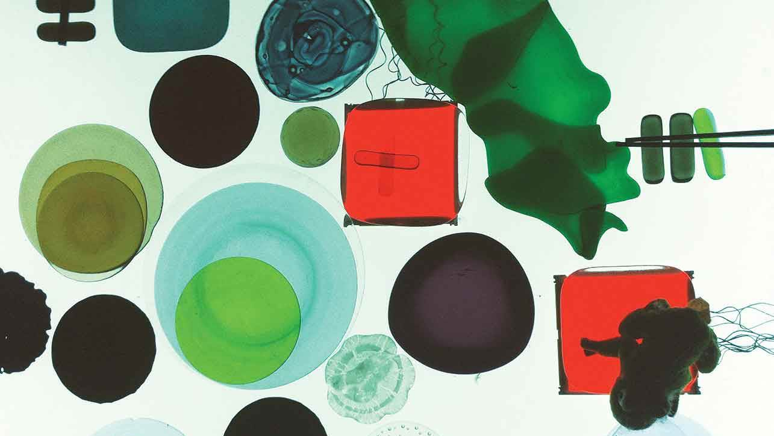
Health & Health Promotion

Slide 3
What is health?
Health is a state of complete physical, mental and social well-being and not merely the absence of disease or infirmity
It is a complex and dynamic concept that encompasses various aspects of our lives, from biology to society, environment, culture, economy, and politics
It is not just about our personal characteristics or genetic makeup, but also the world around us and the conditions we live in
It is shaped by multiple factors, and to truly understand it, we must approach it in a specific way
(WHO, 2016; Sandro, 2021)

Slide 4
What is health promotion?
“Health promotion is the process of enabling people to increase control over and to improve their health”
(W.H.O, 1986)
The social dimension of health is emphasised in the Ottawa Charter for Health Promotion, which argues that health is created in our everyday life contexts where we “learn, work, play and love”. Similarly, art is created in these same settings and may contribute to the promotion of health, wellbeing and social change.
(WHO, 2016)
Ηealth promotion should seek to promote the physical experience of health as well as the social justice, agency and self-determination through empowerment, participation, collaboration and by reducing inequity.
(Chandanabhumma & Narasimhan, 2019)

Slide 5
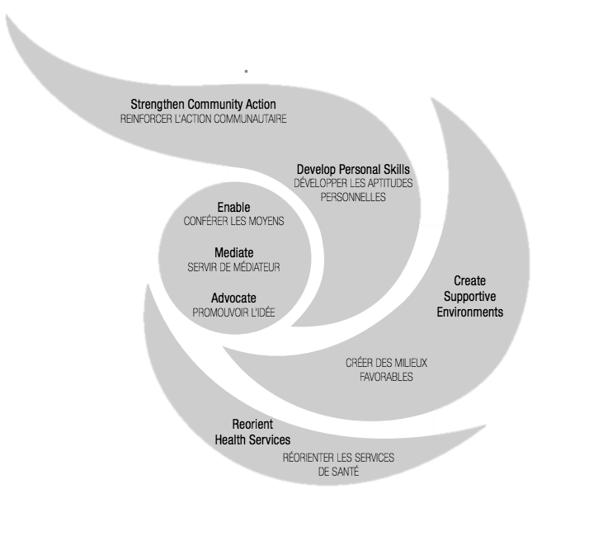
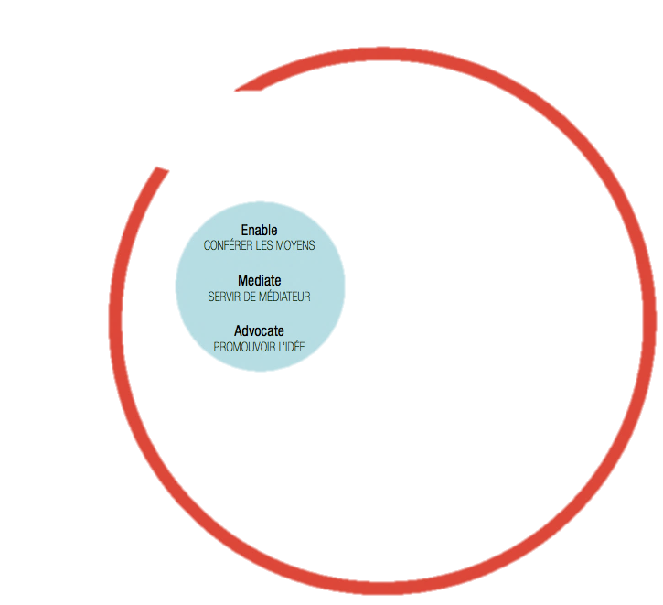
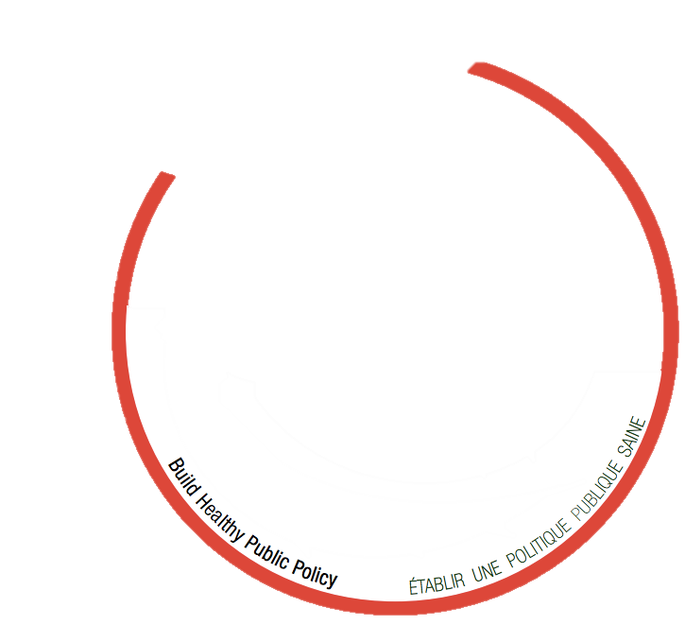
Health Promotion (W.H.O., 1986)
ENABLE Health Promotion aims to achieve full health potential by:
Providing access to health information
Developing life skills
Promoting gender equality
Encouraging healthy choices
Creating supportive environments
MEDIATE Collaboration is necessary between:
Governmental, non-governmental, social, industrial, economic, media, and local sectors
ADVOCATE Effective management and improvement of social, political, economic, cultural, environmental, and behavioural factors is vital for good health.

Slide 6
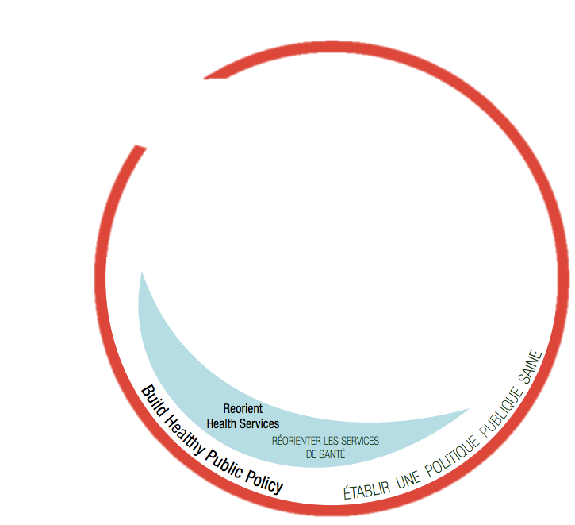
Health Promotion (W.H.O., 1986)
REBUILD
National legislation needs to change, and taxes and organizational structures should be reworked.
REORIENT
Health services should focus on promoting health, not just treating and curing illnesses. We also need to reform how we educate, train, and research staff.
INNOVATE
We need to address health promotion topics such as gender equality, environmentalism, compassion, and holistic approaches.

Slide 7
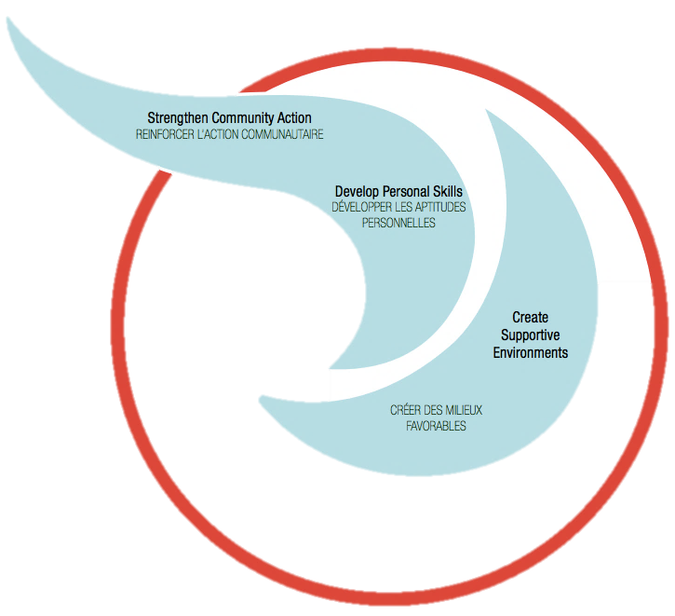
Health Promotion (W.H.O., 1986)
STRENGTHEN
Improving oneself, receiving support from others, and being involved in the community are all important for promoting good health.
DEVELOP
People must address health-related issues such as chronic and infectious diseases and injuries in their daily lives, including at work, at home, at school, and in the community.
CREATE
A socio-ecological approach to health involves protecting natural resources and creating safe, enjoyable, and stimulating living and working conditions

Slide 8
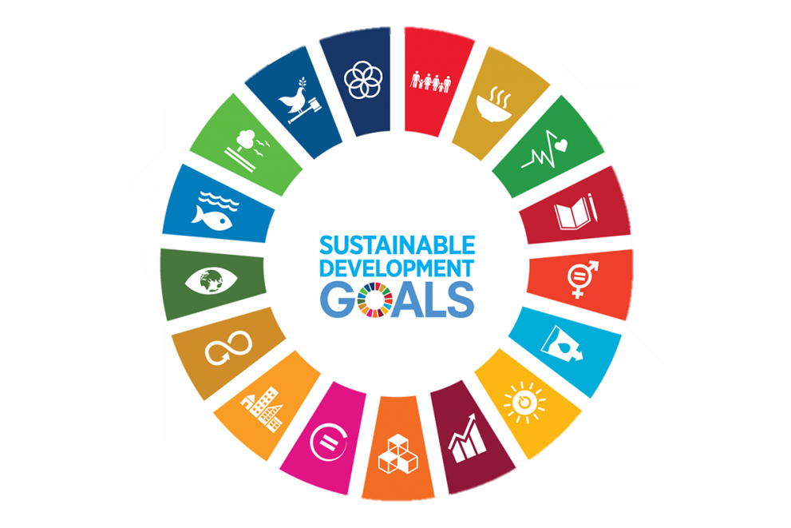
Sustainable Development Goals (SDGs) 2030
The 194 countries of UN General Assembly adopted a new vision for the future, the “Transforming our world: the 2030 Agenda for Sustainable Development”
17 Sustainable Development Goals are identified in order to ensure that all human beings can fulfill their potential in dignity and equality in a healthy environment
(United Nation, 2015)

Slide 9
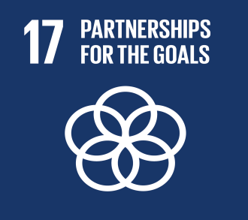
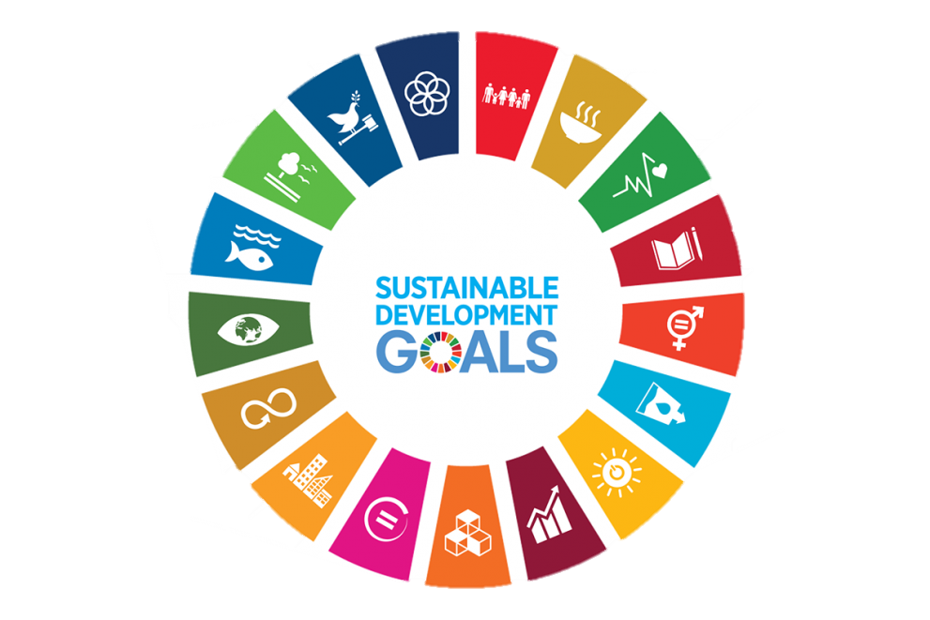
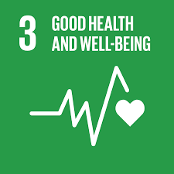
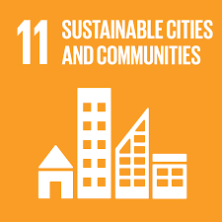
Health Promotion across the SDGs
Goal No 17:
If all countries are to achieve the goals, international cooperation is vital
Goal No 3:
Ensuring people live healthy lives can cut child mortality and raise life expectancy
Goal No 11:
Increase affordable housing and settlements inclusive, safe and sustainable

Slide 10
Creativity & Arts in Health

Slide 11
Artistic expression
The arts grew in lockstep with human cultural development and have long played an integral part in how we teach, learn, communicate, and heal. They are uniquely suited to help us understand and communicate concepts and emotions by drawing on all our senses and capacity for empathy.
Art can help us to…
Navigate the journey of battling an illness or injury
Process difficult emotions in times of emergency and trauma
Recover more quickly from injury or disease
Promote holistic wellness
Be a motivating factor in recovery
Increase positive clinical outcomes for patients
(WHO, 2021)

Slide 12
Creativity is considered to be a complicated and misunderstanding word
It is referred as the ability to respond and involve with the environment making it as something that is unique to us
What is creativity?
Producing or using authentic and unusual ideas making new and useful forms
The ability to respond to the need of new approaches and materials
It is a human part that exceeds from daily and routine ways of thinking and acting
(Greiner & Valiga, 1998; Mullersdorf & Ivarsson, 2012; Hansen et al., 2021; Montuori, 2017)

Slide 13
Art can…
affect the social determinants of health
support child development
encourage health-promoting behaviours
help to prevent health issues
support caregiving
reduce stress
be effective in the treatment of dementia and other conditions associated with ageing
be effective in treating depression and anxiety
play an integral role in health education campaigns
can be used to communicate valuable messages across cultures and political divides
help affected communities understand the risks of certain diseases or behaviours and provide ways for affected populations to process and learn from traumatic events
(WHO, 2021)

Slide 14
Features of Creativity
Creativity is recognized as one of most important skills in 21st century. It is connected to term “creation” that means novel. Creativity is an ecological and divided phenomenon, not isolated.
(Runco, 2015; Montuori, 2017; Kupers et al., 2018)
Creativity is used as a treatment or tool for goals to be achieved in rehabilitation settings.
Acting and thinking out of content
Accept criticism
No attachment to usual practices and no idea judgements
Leader in reforming current and future educational policies
(Greiner & Valiga,1998; Kupers et al., 2018; Hansen et al., 2021)

Slide 15
Writing
Poetry - Literature
Circus
Arts
Theatre
Dance
Concerts
Music
Forms of Creative Methods
Museums
Singing
Reading
Photograph
Sculpture
Ceramics
Games
Drawing
Let’s see in the following slides some more information for some of them and explore a couple of examples…

Slide 16
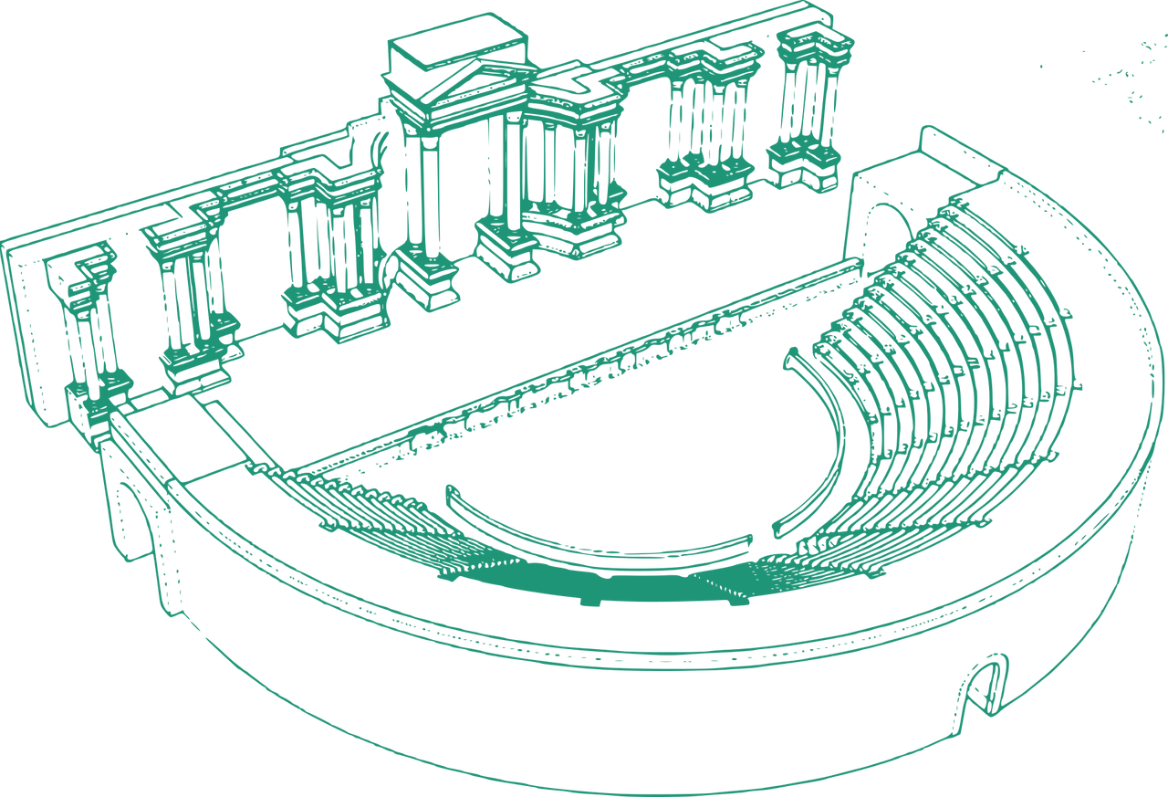
Singing
Enhances physical, mental wellbeing and moral status
Reduces the feeling of loneliness
Reduces the visits to doctors
Decreases the falls
Impairs the medicine intakes
Improves the breathing and quality of life
(Clift, 2012)
Reading
Reading comics and books make people of a community learn for a first time about diseases and health
Messages about health and different diseases can be delivered by comics
People can experience situations by reading
Reading can speed reflection in different aspects
(Burch, 2021)
Theatre
The healing power of theatre is evident in all human cultures. Today, theatre is often cited as the art form that is closest to life itself.
(Pufahl et al., 2021)

Slide 17
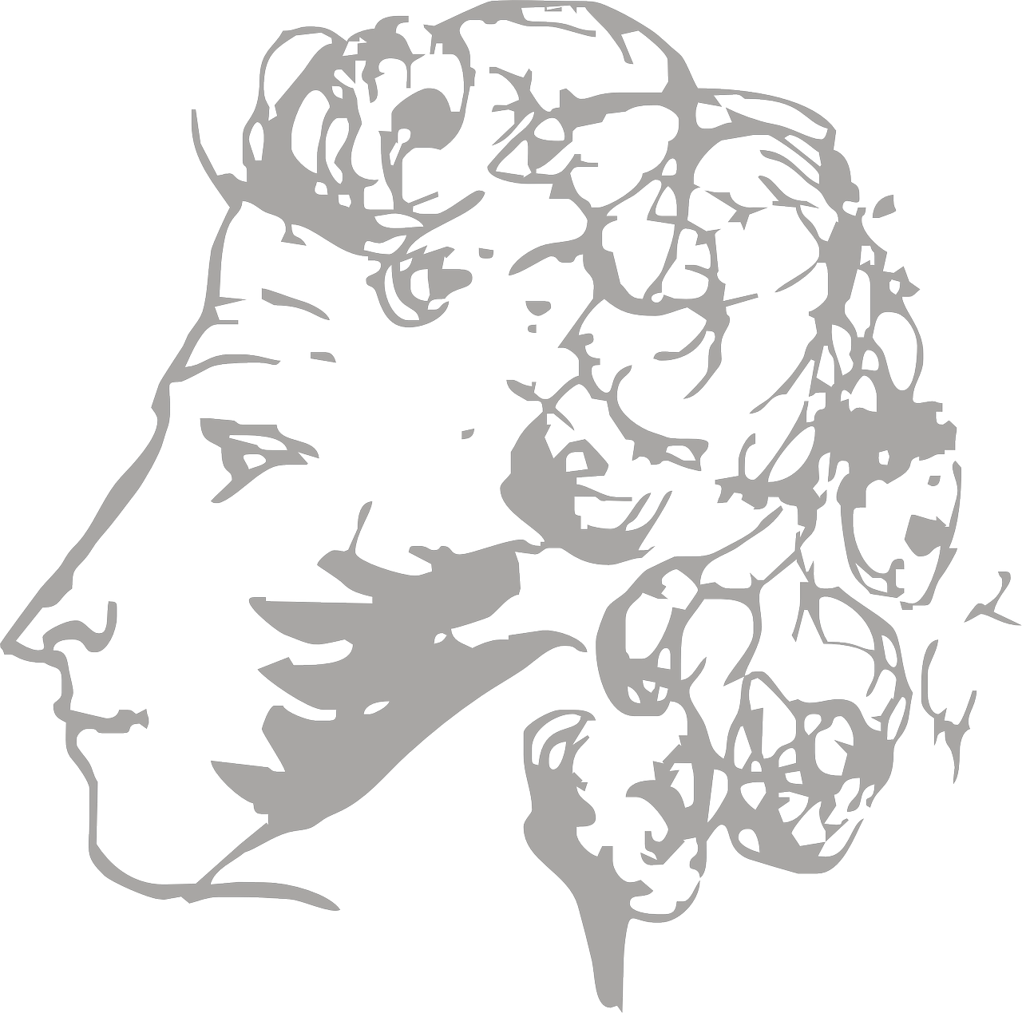
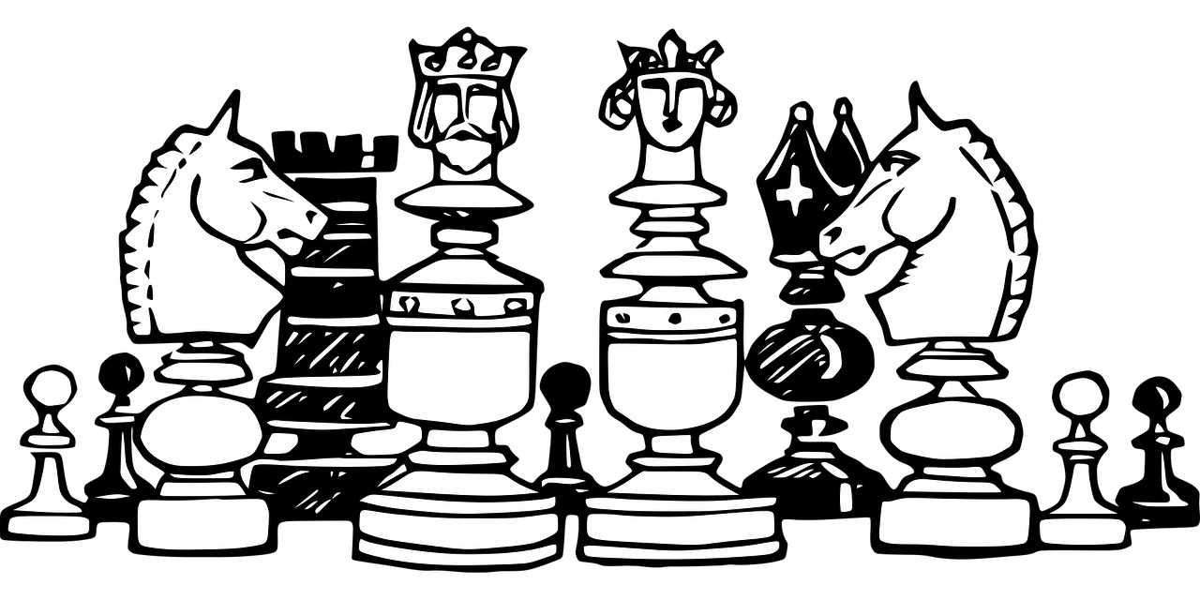
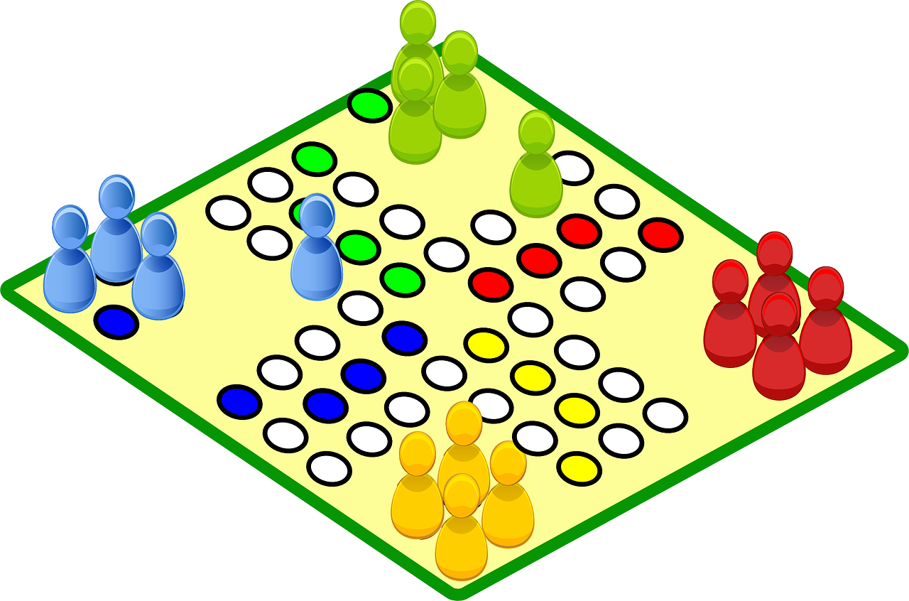
Poetry
It can help children share their experiences and messages about disease prevention
It can increase knowledge about diseases and provide an understanding of their effects on people's health
It can provide insight into how preventive behaviour works
It can release, inspire, transform, and even start a revolution
(Edmondson, 2021; Petteway 2021)
Music
Listening to music can reduce the intensity of pain and the need for painkillers
It can help people feel more prepared
It is essential for social and emotional development, as well as mental well-being and resilience in children
(Leis & Morrison, 2021)
Games
They tend to involve participants and increase their motivation and interest
Participants learn while taking part in a game, and the joy they experience is helpful for the learning process
(Bartfay & Bartfay, 1994)

Slide 18
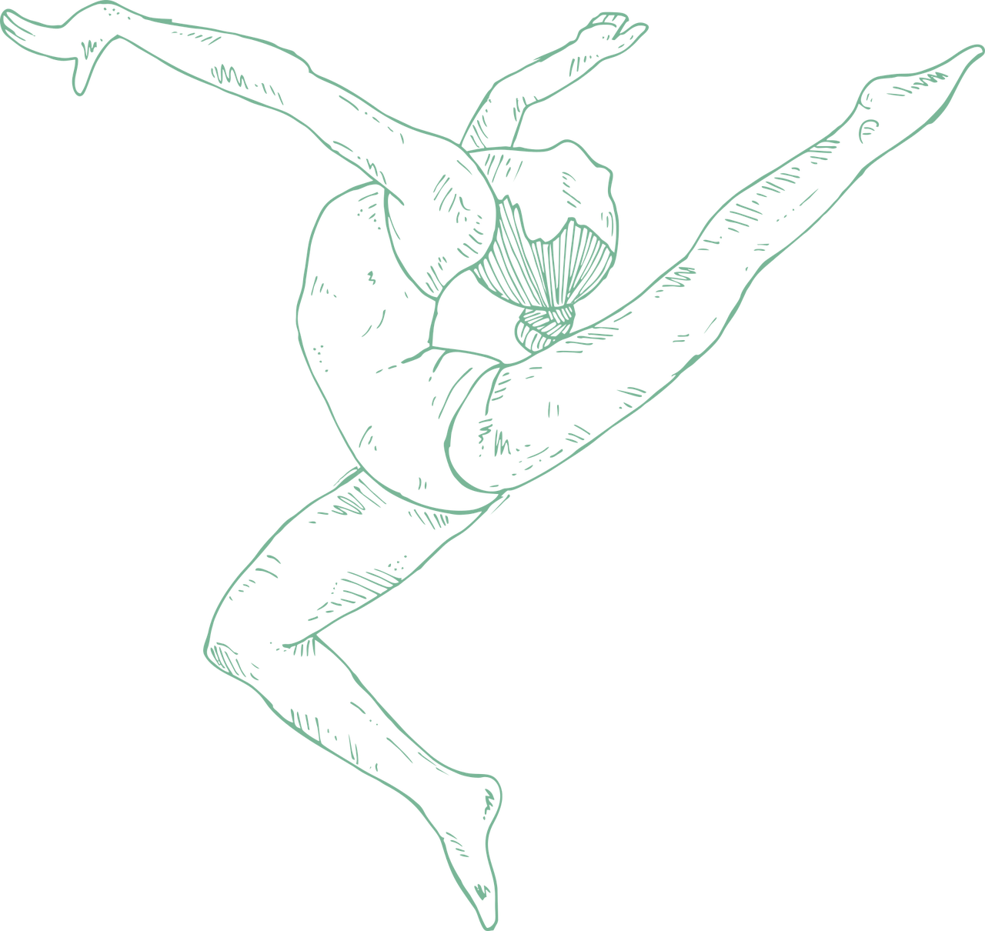
Dance
It can offer continuous and reliable physical support
Emotional connection
Social interaction
Public Health matters address, like stress and anxiety, limited moving, isolation, lack of help and healthy behaviours adoption
(Kelly & Leventhal, 2021)
Drawing
Drawing is an activity that can improve sensory motor skills, encourage the use of imagination, help develop creativity, and, above all, be a fun and enjoyable pastime.
It can also be an important method of communication and a tool for exploring complex and when we need to address difficult and challenging issues.
(Vendeville et al. 2018)

Slide 19
Some suggestions on how health service organizations can promote cultural wellbeing
Listening together to an exciting program on the radio and discussing the thoughts it provokes
Help the patient reflect on his condition employing literary art
Remembering to follow appropriate hand hygiene practices can be supported by composing a rhyme
A relatable short film can provide a more effective and multi-layered account of a peer experience than an ordinary discussion
Activities such as guest performances, open rehearsals, workshops and exhibitions can be organised on the health service organisations’ premises
Recounting life experiences to others helps the healthcare professionals to better acquaint with a client and learn more about cultural background and needs
Forming choirs and theatre groups, etc.
(Koivisto et al., 2020)

Slide 20
A few examples among young people...

Slide 21
Tell Me What You See: An Arts-Based Health Education Program for Youth
The “Tell Me What You See” initiative utilises artwork and poetry created by incarcerated youth to promote prevention of sexually transmitted infections, HIV, and hepatitis with students in public high schools and juvenile justice facilities.
This innovative intervention integrates functional health knowledge and skills-based education through an art-based interdisciplinary approach reaching various populations of youth in multiple settings.
Evaluation results indicated that the materials effectively engage youth and open up a critical dialogue among peers and adults by addressing the role personal behaviour can have in the prevention of sexually transmitted infections, HIV, and hepatitis.
(Edmondson, 2021)

Slide 22
Participating in creative activities on the health and well-being
An early rapid review (Bungay & Burrows, 2013) has concluded that participating in creative activities can have a positive effect on behavioural changes, self-confidence, self-esteem, levels of knowledge and physical activity. More specifically:
Sexual health: drama is a particularly effective health education intervention because events are used from everyday life and the visual format demonstrates examples of how to deal with difficult situations. It allows discussions to be depersonalised while dealing with issues from the perspective of a young person.
Obesity: theatre could be used to educate young people about healthy eating and diet, while dance can be used as a form of exercise to increase physical activity as not all young people enjoy sports as a form of exercise.
Mental health and emotional well-being: engaging in arts activities has a valuable role in promoting mental health and well-being. These approaches help to build communities and increase social engagement and therefore, increase confidence, self-esteem, sense of achievement, empowerment, social skills, and positive behavioural changes.

Slide 23
Are there any health promotion initiatives with creativity approaches in your communities?
Why not explore further?

Slide 24
References
Bartfay, W., & Bartfay, E. (1994). Promoting health in schools through a board game. West J Nurs Res, 16(4), 438-446. https://doi.org/10.1177/019394599401600408
Bungay, H., & Vella-Burrows, T. (2013). The effects of participating in creative activities on the health and well-being of children and young people: a rapid review of the literature. Perspect Public Health, 133(1), 44-52. https://doi.org/10.1177/1757913912466946
Burch, S. (2021). Perspectives on Racism: Reflections on Our Collective Moral Responsibility When Leveraging Arts and Culture for Health Promotion. Health Promotion Practise, 22(1), 12-16. https://doi.org/10.1177/1524839921996073
Chandanabhumma, P.P., & Narasimhan, S.(2019). Towards health equity and social justice: An applied framework of decolonization in health promotion. Health Promotion International, 35(4), 831-840. https://doi.org/10.1093/heapro/daz053
Clift, S. (2012). Creative arts as a public health resource: moving from practice-based research to evidence-based practice. Health Promotion Practise, 132(3), 120-127. https://doi.org/10.1177/1757913912442269
Edmondson, B. (2021). Tell Me What You See: An Arts-Based Health Education Program for Youth. Health Promotion Practice, 22(1), 27-30. https://doi.org/10.1177/1524839921996634
Greiner, P., & Valiga, T. (1998). Creative educational strategies for Health Promotion. Holistic Nursing Practice, 12(2), 73-83. https://doi.org/10.1097/00004650-199801000-00011
Hansen, B., Erlandsson, L., & Leufstadius, C. (2021). A concept analysis of creative activities as intervention in occupational therapy. Scandinavian Journal of Occupational Therapy, 28(1), 63-77. https://doi.org/10.1080/11038128.2020.1775884
Institute of Medicine. (1998). The future of public health. National Academies Press
Kelly, M.P., & Leventhal, D. (2021). Dance as Lifeline: Transforming Means for Engagement and Connection in Times of Social Isolation. Health Promotion Practise, 22(1), 64-69. https://doi.org/10.1177/1524839921996332
Koivisto, T., Lehikoinen, K., Lapio, P., Viherlampi, L., & Salantera, S. (2020). Culture and the Arts in Hospitals and Other Health Service Organisations. Art Equal Policy Brief. https://www.academia.edu/49342394/Culture_and_the_Arts_in_Hospitals_and_Other_Health_Service_Organisations
Kupers, E., Van Dijk, M., & Lehman-Wermser, A. (2018). Creativity in the Here and Now: A Generic Microdevelopmental measure of creativity. Front Psychol, 9, 2095. https://doi.org/10.3389%2Ffpsyg.2018.02095
Leis, J., & Morrison, C. (2021). An Integrative Review of Arts-Based Strategies for Addressing Pain and Substance Use Disorder During the Opioid Crisis. Health Promotion Practise, (22)1, 44-52.https://doi.org/10.1177/1524839921996065

Slide 25
References
Montuori, A. (2017). Nature of Creativity. In: Encyclopedia of Creativity, Invention, Innovation and Entrepreneurship. Springer. https://doi.org/10.1007/978-1-4614-6616-1_383-2
Müllersdorf, M., & Ivarsson, A. (2012). Use of creative activities in occupational therapy practice in Sweden. Occupational Therapy International, 19(3), 127-134. https://doi.org/10.1002/oti.1327
Petteway, R.J. (2021). Poetry as Praxis + “Illumination”: Toward an Epistemically Just Health Promotion for Resistance, Healing, and (Re)Imagination. Health Promotion Practice, 22(1), 20-26. https://doi.org/10.1177/1524839921999048
Pufahl, J., Munoz, C., & Bayne, H. (2021), Theatre Connect: Key Strategies for Facilitating LGBTQQ Youth Theatre Programs. Health Promotion Practice, 22(1), 31-34.https://doi.org/10.1177/1524839921996290
Runco, M. (2015). A Commentary on the Social Perspective on Creativity. Creativity theories, Research, Applications, 2(1), 21-31. https://doi.org/10.1515/ctra-2015-0003
Sandro G. (2021). The Arts and Public Health: Changing the Conversation on Health. Health Promotion Practice, 22(1), 8-11. https://doi.org/10.1177/1524839921996341
United Nations. (2015).Transforming our World: The 2030 Agenda for Sustainable Development. https://sustainabledevelopment.un.org/post2015/transformingourworld/publication
Vendeville, N., Blanc, N., & Brechet, C. (2018). Tears for girls and teeth for boys: The influence of gender on children’s depiction of sadness and anger in their drawings. Educational Psychology, 1–18. https://doi.org/10.1080/01443410.2018.1461810
World Health Organization. (1986). The Ottawa Charter for Health Promotion. https://www.who.int/teams/health-promotion/enhanced-wellbeing/first-global-conference
World Health Organization. (2016). The 1st International Conference on Health Promotion, Ottawa, 1986. https://www.who.int/teams/health-promotion/enhanced-wellbeing/first-global-conference
World Health Organization. (2021). Healing Arts Launch Event: The Arts and Wellbeing. https://www.who.int/news-room/events/detail/2021/09/19/default-calendar/healing-arts-new-york-launch-event-the-arts-and-wellbeing

Slide 26
This work is licensed under the Creative Commons Attribution-Non Commercial-Share Alike 4.0 International License.

